Slide 1
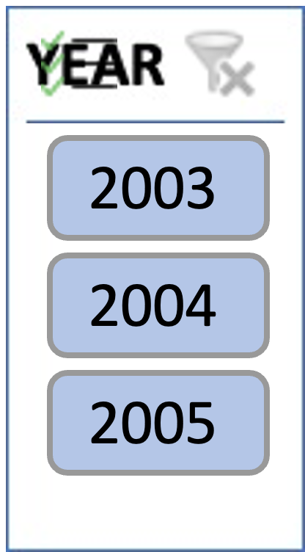
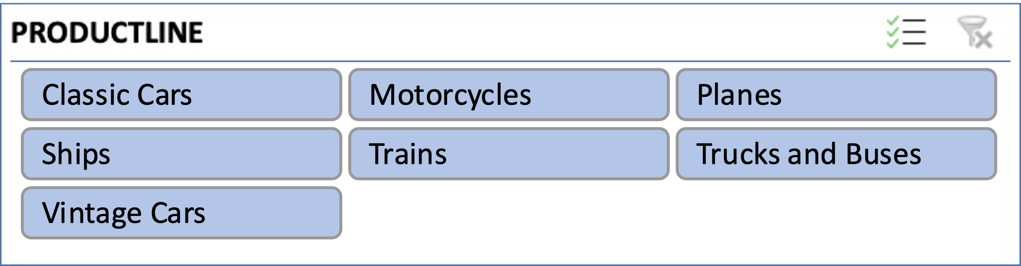
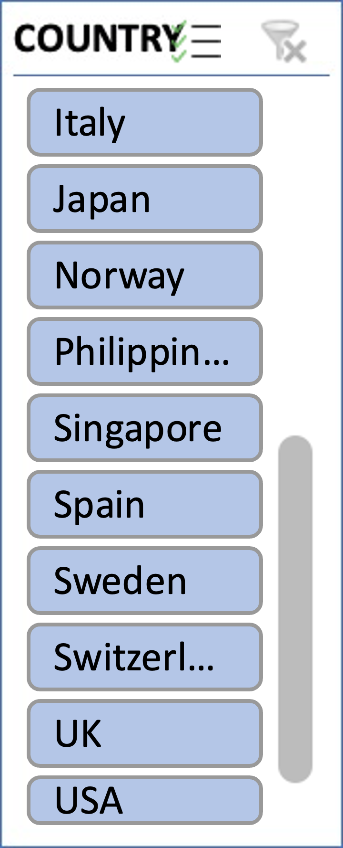
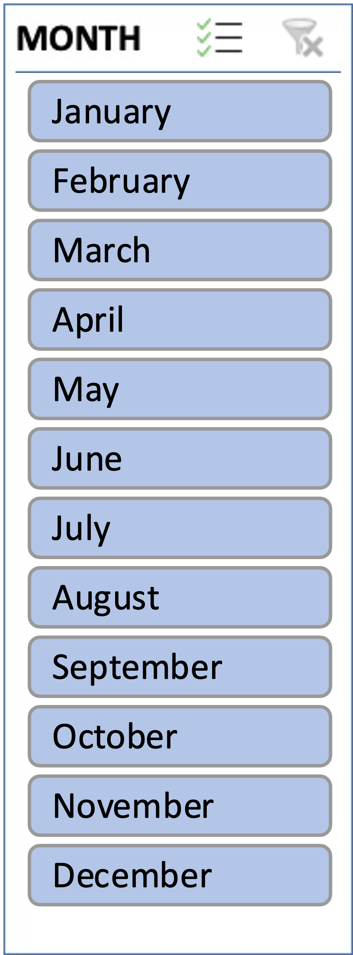
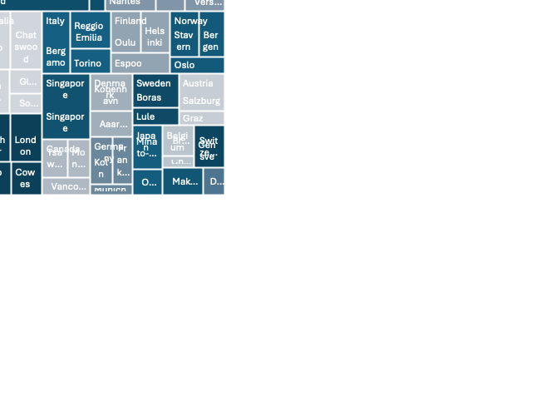


Slide 2
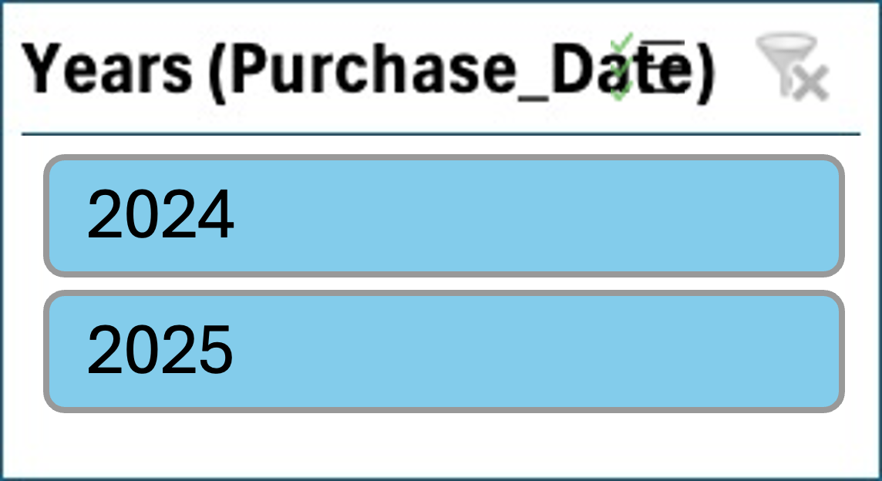
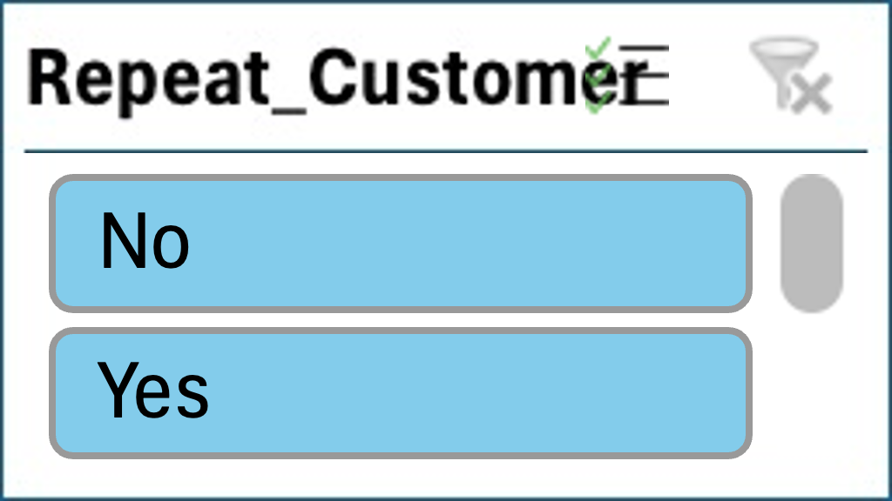
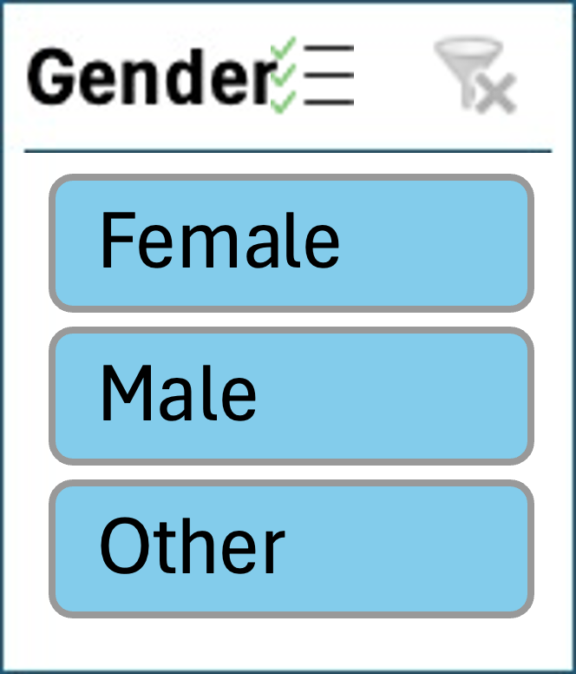
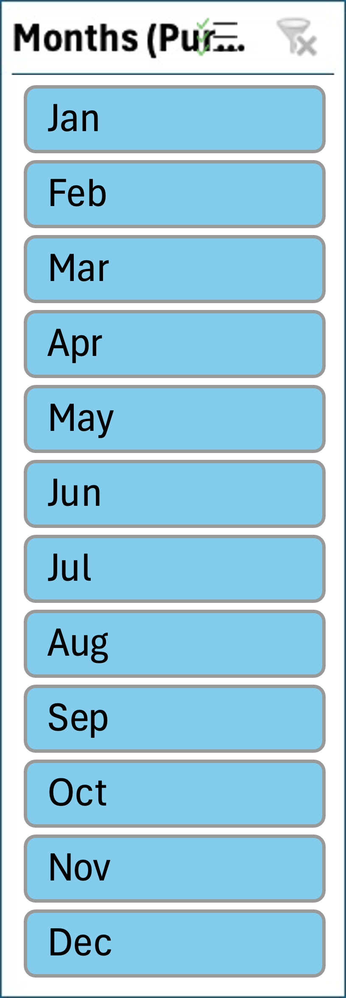
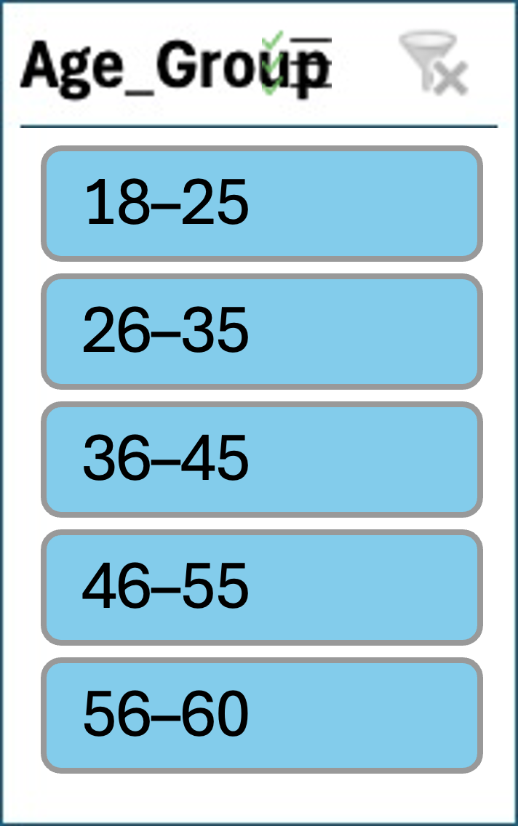
Walmart Customer Purchase Behaviour
Insights from 2024 – 2025
Total Product Sold
Repeat Customer Rate:
Average product rating by category
Popular product:
Method of Payment
Customer Preference Distribution
Monthly Sales and Average Ratings
Customer Distribution by Age Group

Slide 3
Walmart Customer Purchase Behaviour
Insights from 2024 – 2025
Total Product Sold
Repeat Customer Rate:
Average product rating by category
Popular product:
Method of Payment
Customer Preference Distribution
Monthly Sales and Average Ratings
Customer Distribution by Age Group

